Slide 1


Slide 2



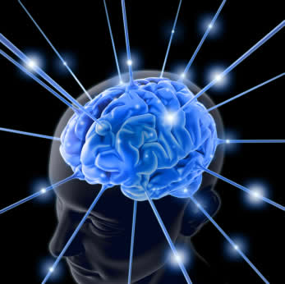
iNTerAcTive DesiGn
BRAIN COMPUTER INTERFACE
For Terminally Disabled Individuals
Notes:
To view this presentation, first, turn up your volume and second, launch the self-running slide show.

Slide 3



iNTerAcTive DesiGn
BRAIN COMPUTER INTERFACE
For Terminally Disabled Individuals
Capt Muhammad Naveed Sharif
Capt Yasir Ishaq Hashmi
Nc Hafiz Abdul mannan
Notes:
Presentations are a powerful communication medium.

Slide 4
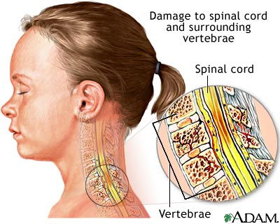
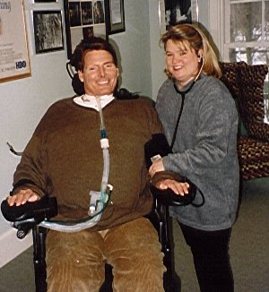
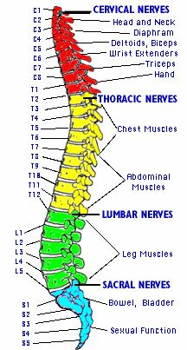
Back Ground
Spinal Cord Injuries
“About 11,000 people in the United States suffer
a traumatic spinal cord injury (SCI) each year.
At present, between 250,000 to 400,000 Americans
live their daily lives with a SCI disability”.
Note :USA`s Population is 4.47% of world population.
Notes:
To view this presentation, first, turn up your volume and second, launch the self-running slide show.

Slide 5
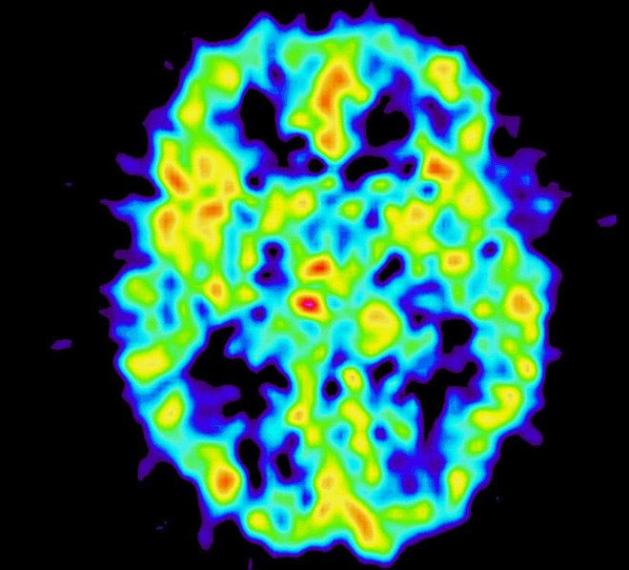
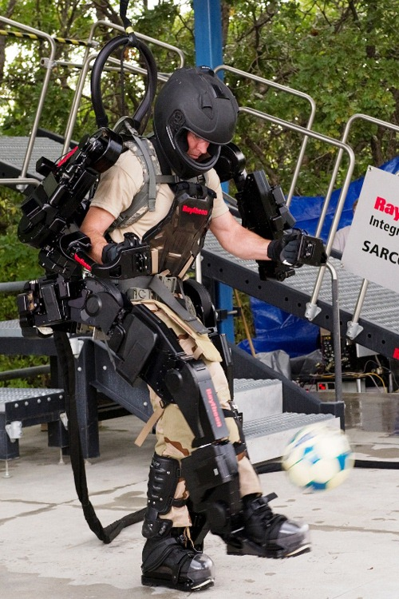
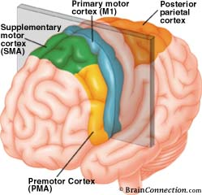
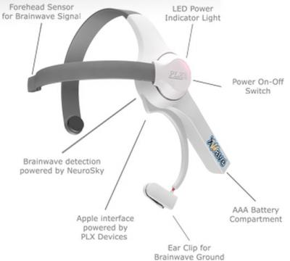
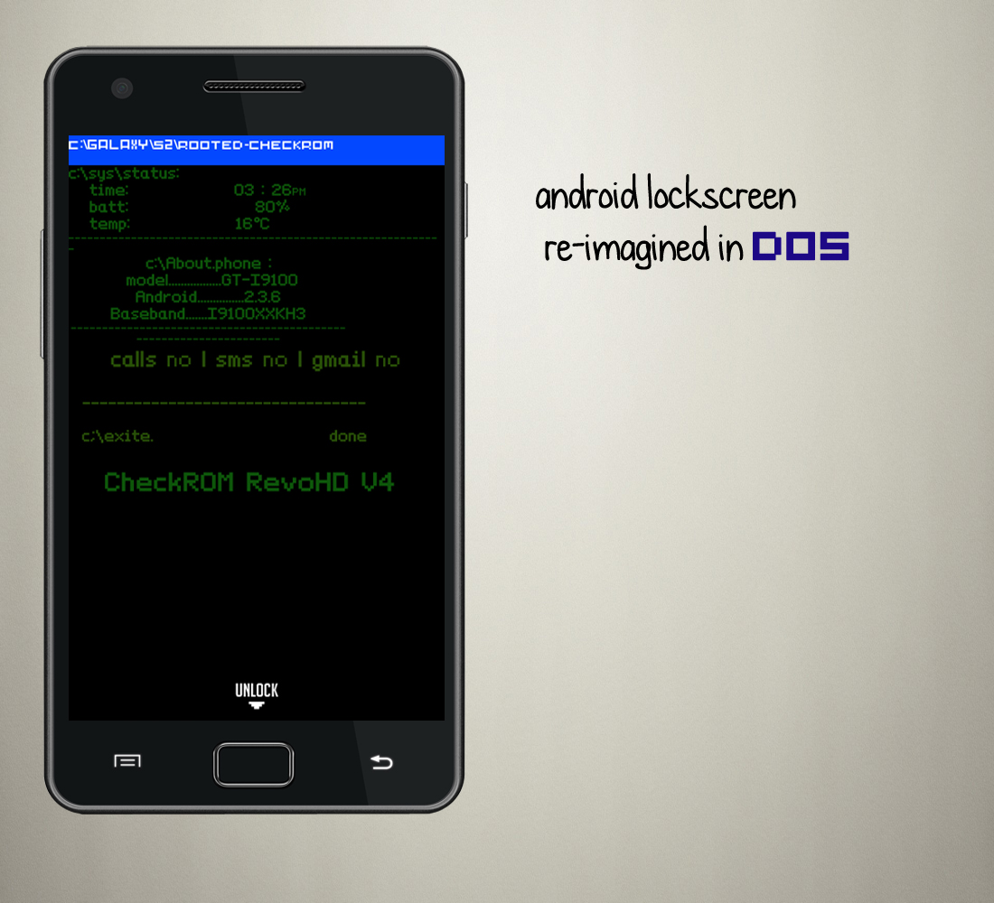
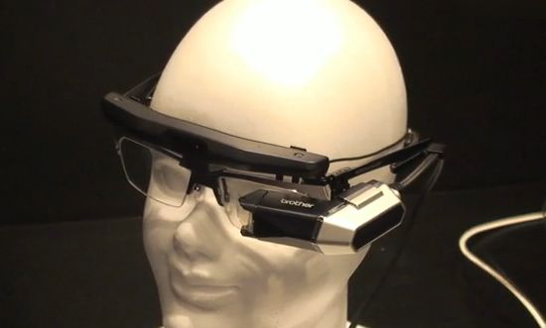
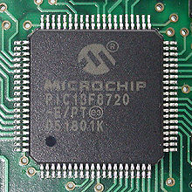
Solution
Motor Cortex
Electric Signals
Non Evasive Signal
Detection
Computer (Smartphone)
Head On Display
(Augmented vision)
Microcontroller
Powered Exoskeleton
Notes:
To view this presentation, first, turn up your volume and second, launch the self-running slide show.

Slide 6
PACT Analysis
People
Users.
Special Persons
All Possible Disabled Human Beings With a Fully functional Brain ,Eyes, Ear and
Speech
Developers
Electrical Engineers-With specialization in Neuroinformatics
Software Engineering with Knowledge of Image processing and signal processing
Mechatronics Engineer
Physical Limitations:
Thinking/Thoughts which we all possesses no matter how limited our abilities may be physically.
Psychological Difference:
simple actions
simple day to day tasks
Notes:
To view this presentation, first, turn up your volume and second, launch the self-running slide show.

Slide 7
PACT Analysis
Activities
Following is the list of Activities as perceived to be performed by the system;
1. Sitting on chair
2. Walking straight line or on a irregular path.
3. Picking and handling objects.
Temporal Aspects:
Don’t need the cooperation of second person
Except the basic step of fixing and removing the
Complexity
Forcefully set lowered due to limitation and ability of the target user.
Safety Critical
The basic limits of human body .
Physically applied lock and limiters to limit an excessive motor action.
All time aware of the location stature and Vital signs of the User
An anti-fall system to minimize damage to user.
The Nature of the content
Analog signals are mapped using imaging processing .
Performed by the exoskeleton which is basically made up gear and leavers
3D camera Project with help of sensors project augmented information on HUD

Slide 8
PACT Analysis
Context:
Physical
in both indoor as well as limited outdoor application.
Social
any effects his relative immediately in a positively way.
Technologies:
Input – Human Thought processes produces brain activity in form of electric fluxes.
Also input of following sensors / devices help in safety of the user
1. Gyros
2. GPS
3. 3g Communications
4. Proximity Sensors
5. Pressure Sensors
6. Accelerometer

Slide 9
PACT Analysis
Output – The Hub computer after recognizing the thought processes
-to specified components of the exoskeleton to execute the Movement.
-to Augmented HUD goggles as information of surroundings/situational awareness
Communication – The communication in the system is done in four layer .
1st layer –Brain level
Brain electrical activity is translated in to pattern
2nd layer – Hub computer
The pattern is first saved and then initiated when recognized a set of signals to
specified components of the exoskeleton
3rd layer –Exoskeleton
The micro controllers placed with each set of Muscle replication devices
(motors gear and levers) after receiving specific signals controls the operation of the devices
in order to perform a specific Motion.
4th Layer – HUD Goggles
The HUD Goggles are the primary display unit of the system and communicates directly with surrounding
Using 3D cameras and Laser Range finder and Augments the field of view with relevant information.
It also incorporates the display of different sensors such as gyro , proximity sensor.

Slide 10


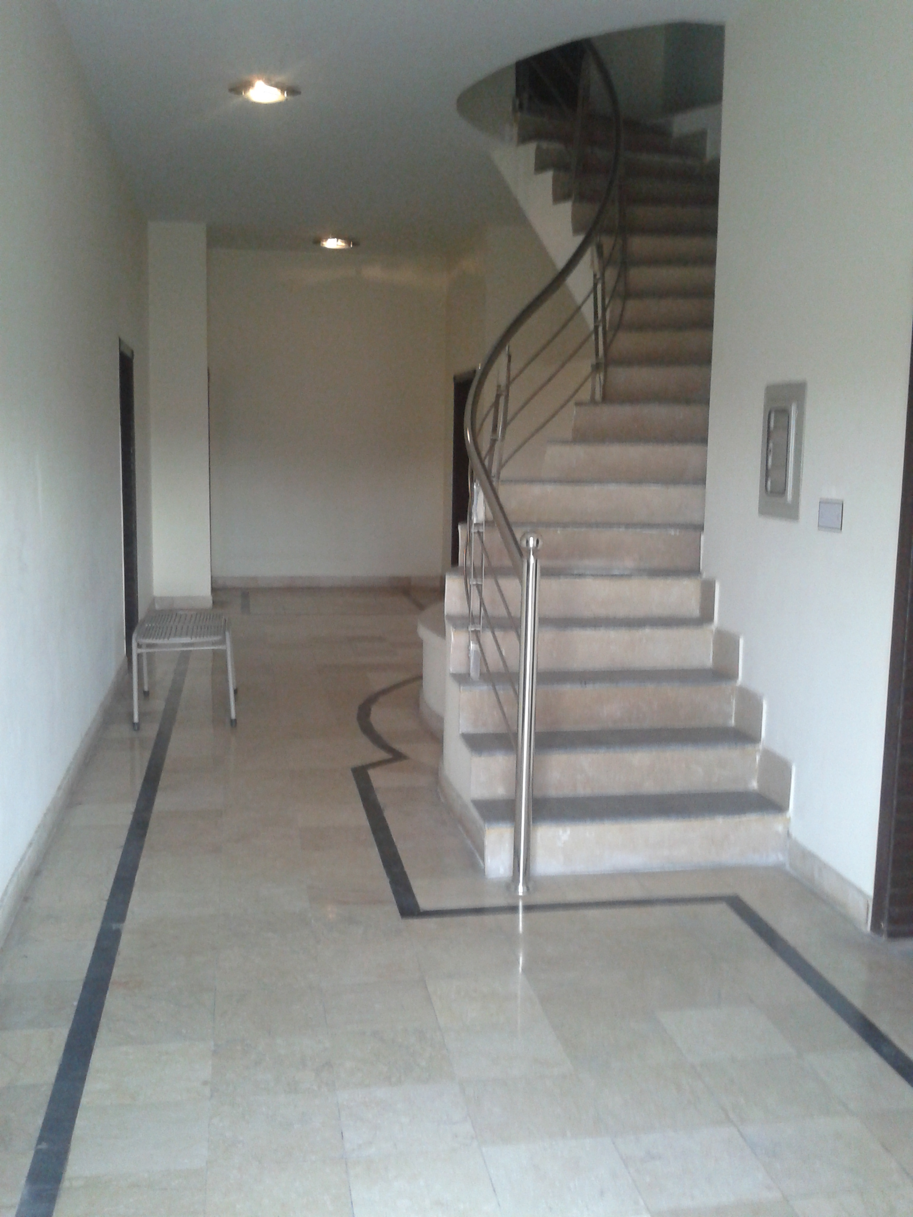




8 m
3 m
2 m

Slide 11

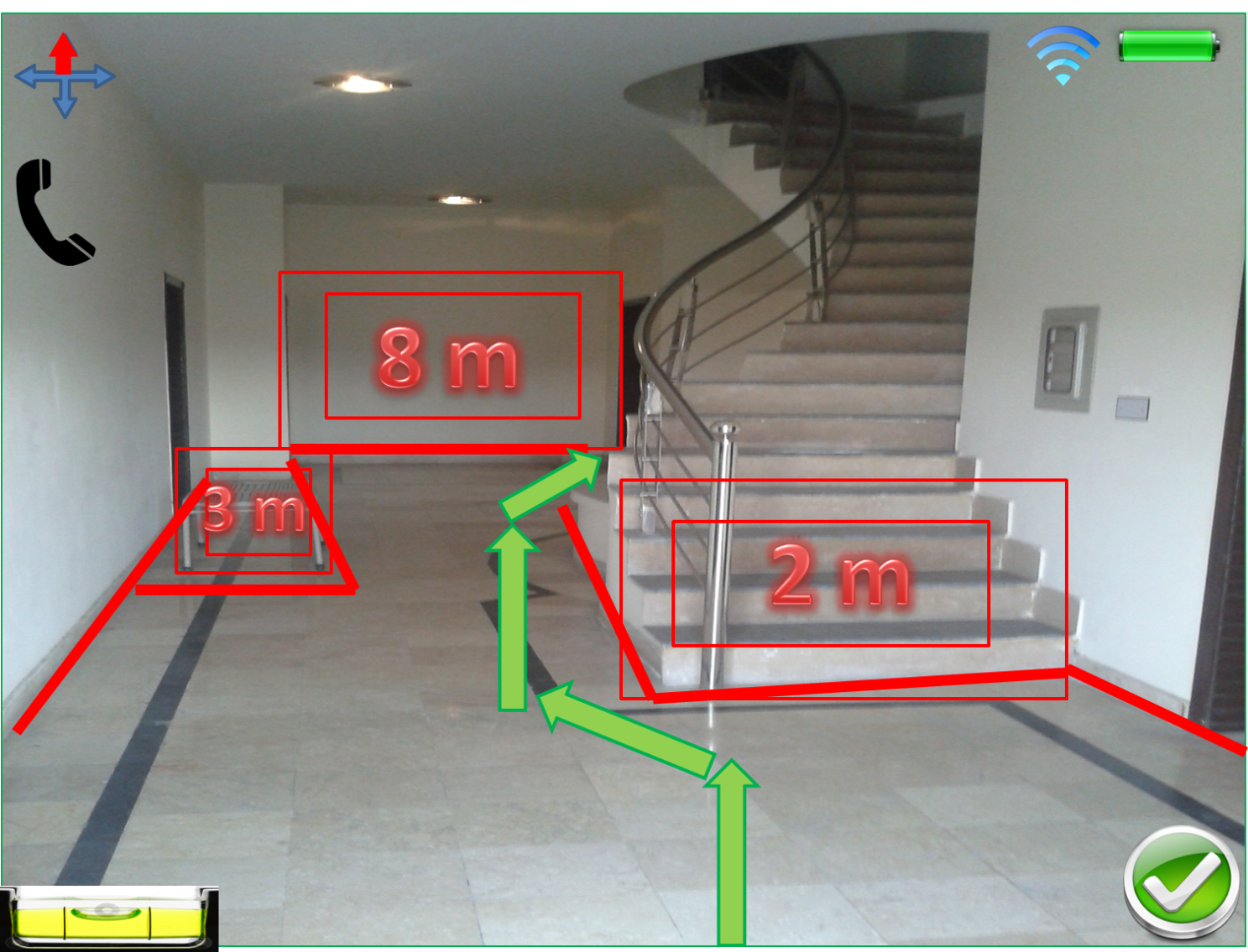
Horizontal Prototype

Slide 12
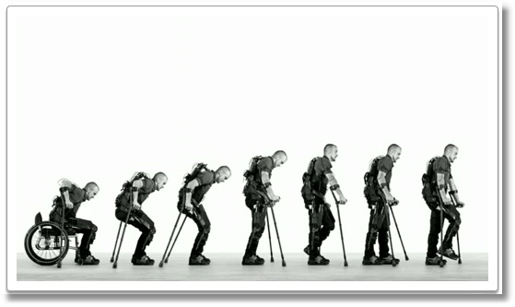
Scenario Prototype

Slide 14
Task Analysis
Top level Goals
“To Provide a system through which a terminally disabled individual regain some level of physical activity in order to minimize the psychological effect of his injury”
“To provide the user a safety critical system as per the physical condition of the user requires”
“To provide simpler set of interface for the user with limited abilities in order to fully interact with the system”.

Slide 15
Tasks List
Sitting on chair
Standing up
Walking straight line or on a irregular path.
Picking and handling objects.
Making calls to base station
Navigating through Obstacles

Slide 16
Sub Tasks
Standing from the chair and walking

Slide 17
Task Analysis
Pre-Conditions
Already Strapped to the Exoskeleton
System Powered Up
System Scanned and checked
User is willing and mentally relaxed
Battery full
Assumptions:
The user has suitable pre training with help of the Developer team
The exoskeleton has be extensively tested for safety critical issues

Slide 18
Sub Tasks( for single body motion)
The user wishes to stand up and walk
The thought process generates brain waves in the primary motor Cortex
These brain waves are picked up by the Brain wave sensor and sent as analog signals to the Hub computer
Hub computer with the help of software decodes the analog signals into commands as per the required motion and send corresponding signals to the microcontrollers in the Exo Skeleton
The Microcontrollers in the Exo skeleton generate synchronous electric signals to different motors and pulleys in the exoskeleton to perform a motion.
Microcontrollers constantly return feedback signals upon completion of the previous command.

Slide 19
User Reponses
Before the task starts
User is willing and mentally relaxed
The user has suitable pre training with help of the Developer team and Doctors
After Completion of a task
The Completion of task is achieved by users satisfaction latterly as a brain wave signals upon the completion of a task.
Anxiety and frustration will result in brain signals corresponding to lack of completion of a particular task.
Also if case the system also recognized if a corresponding motion is not completed and delivers a warning signals on HUD as well as the same is communicated to the base station.

